Slide 1
Multithreading in JAVA
改编自Daniel Liang: Introduction to programming JAVA课件

Slide 2
线程与进程
进程（process）单独分配资源，有独立的内存空间
线程属于进程内部，共享进程的地址空间和资源，是CPU调度的最小单位

Slide 3
What is a Thread?线程
Think ‘thread of execution’ or ‘thread of control flow’.
Java allows a program to have multiple threads running concurrently.
What does this mean to us as developers?

Slide 4
Threads Concept
Multiple threads on multiple CPUs
Multiple threads sharing a single CPU

Slide 5
Single-Threaded Development
Many programs written for class so far have been single-threaded.
When you call a method, it only returns once its task is complete.

Slide 6
Thread ‘Stalling’
What happens when a method needs to wait for something before returning, such as user input or a network connection? (Recall accept() from last lecture)
How can we handle other tasks while waiting to accept a new network connection?

Slide 7
Multithreading
Answer: Accept connections in a different thread.
Java allows us to create new threads for handling concurrent tasks.

Slide 8
How?
Java provides two ways to create a new thread.
Extend the Thread class (java.lang.Thread)
Implement the Runnable interface (java.lang.Runnable)

Slide 9
Java’s Thread Class
When creating a new thread by extending the Thread class, you should override the run() method.
public class FooThread extends Thread { public FooThread() { // Initialize parameters } public void run() { // do something } }

Slide 10
Now What?
To start a new thread, use the inherited method start()
FooThread ft = new FooThread(); ft.start();

Slide 11
What happens in start()?
start() is responsible for two things:
Instructing the JVM to create a new thread
Call your Thread object’s run() method in the new thread
You might think of run() as being similar to main()

Slide 12
More about Thread.run()
Like main(), run() defines a starting point for the JVM.
What happens when the run() method exits?
The thread ‘ends’.

Slide 13
Another method - Runnable
A thread can also be created by implementing the Runnable interface instead of extending the Thread class.
public class FooRunnable implements Runnable { public FooRunnable() { } public void run() { // do something } }

Slide 14
Starting a Runnable
Pass an object that implements Runnable to the constructor of a Thread object, then start the thread as before.
FooRunnable fr = new FooRunnable(); new Thread(fr).start()

Slide 15
Multithreading Pros and Cons
Pro: Multiple threads run concurrently on the system
Multiple tasks can be handled at once.
Processing can be done in the background so as not to interrupt the user.
Con: Multiple threads run concurrently on the system
No more guarantees as to what has already happened, what objects have been initialized yet, etc.
Code now has to be ‘thread-safe’ or ‘synchronized’
Debugging becomes much harder.

Slide 16
Tips for Writing Thread-safe Code
Limit a thread’s access to common variables
Track changes to instance variables through get/set methods
When two or more threads are accessing a collection, make sure the collection being used is synchronized (i.e. using Vector instead of ArrayList)

Slide 17
How do I stop it??
Methods used to directly stop or suspend threads have been depreciated in the Java API, as they could cause synchronization issues.
The thread’s run() method must return for the thread to stop.

Slide 18
Interesting Facts
In many of your Swing programs, main() has consisted of creating a new JFrame object and calling show() on it
show() actually starts a new thread that the GUI runs in and returns immediately – main() then returns. Why doesn’t your program end when main() does?
Java applications only exit when all of their threads have stopped.

Slide 19
Would you like to know more?
Refer to the Java API

Slide 20
Creating Tasks and Threads

Slide 21
Using the Runnable Interface to Create and Launch Threads
Demo
TaskThreadDemo.java

Slide 22
The Thread Class

Slide 23
The Static yield() Method
TaskThreadDemo.java:
public void run() {
for (int i = 1; i <= lastNum; i++) {
System.out.print(" " + i);
Thread.yield();
}
}
Every time a number is printed, the print100 thread is yielded. So, the numbers are printed after the characters.

Slide 24
The Static sleep(milliseconds) Method
public void run() {
for (int i = 1; i <= lastNum; i++) {
System.out.print(" " + i);
try {
if (i >= 50) Thread.sleep(1);
}
catch (InterruptedException ex) {
}
}
}
Every time a number (>= 50) is printed, the print100 thread is put to sleep for 1 millisecond.

Slide 25
The join() Method
TaskThreadDemo.java:
The numbers after 50 are printed after thread printA is finished.

Slide 26
isAlive(), interrupt(), and isInterrupted()
isAlive() ：It returns true if a thread is in the Ready, Blocked, or Running state; it returns false if a thread is new and has not started or if it is finished.
interrupt()： If a thread is currently in the Ready or Running state, its interrupted flag is set; if a thread is currently blocked, it is awakened and enters the Ready state, and an java.io.InterruptedException is thrown.
isInterrupt() ：tests whether the thread is interrupted.

Slide 27
NOTE: The Thread class also contains the stop(), suspend(), and resume() methods. As of Java 2, these methods are deprecated (or outdated) because they are known to be inherently unsafe. You should assign null to a Thread variable to indicate that it is stopped rather than use the stop() method.

Slide 28
Thread Priority
Each thread is assigned a default priority of Thread.NORM_PRIORITY. You can reset the priority using setPriority(int priority).
Some constants for priorities include Thread.MIN_PRIORITY Thread.MAX_PRIORITY Thread.NORM_PRIORITY

Slide 29


Demo: Flashing Text
FlashingText.java
通过线程sleep实现动画功能

Slide 30
GUI Event Dispatcher Thread
GUI event handling and painting code executes in a single thread, called the event dispatcher thread. This ensures that each event handler finishes executing before the next one executes and the painting is not interrupted by events.

Slide 31
invokeLater and invokeAndWait
invokeLater method returns immediately, without waiting for the event dispatcher thread to execute the code.
The invokeAndWait method is just like invokeLater, except that invokeAndWait doesn't return until the event-dispatching thread has executed the specified code.

Slide 32
Launch Application from Main Method
public static void main(String[] args) {
SwingUtilities.invokeLater(new Runnable() {
public void run() {
// Place the code for creating a frame and setting it properties
}
});
}
SwingUtilities：关于swing的一些实用方法在这个类中
javax.swing

Slide 33
Timers
A Timer will internally launch a new thread, but handle most of the work for you.
A Timer will call a method when its interval expires.

Slide 34
Timer Guidelines
Timers should be performing quick tasks, such as updating simple state.
If a timer is performing a complex operation, its next interval may expire before it finishes, and the timer will become backlogged (bad)

Slide 35
Common Uses for Timers
Timed events or scheduled updates
Delay events for a specified time
Animation

Slide 36
Creating Timers
Java has two Timer classes – one located in java.util and one in javax.swing. We’ll be dealing with the one in the Swing library.
Important timer methods:
public Timer(int ms_delay, ActionListener al)
public void start()
public void stop()

Slide 37
Wait, an ActionListener?
Timers take a delay (in milliseconds) and an ActionListener object in their constructor.
Once a timer has started, it will call the ActionListener’s ActionPerformed() method each time its interval expires.

Slide 38
Timer Advantages Over Threads
Simplicity!
The familiar ActionListener interface and internal handling of the thread bookkeeping makes timers much easier to use and maintain than full threads.
What you gain in simplicity, you give up in flexibility.

Slide 39
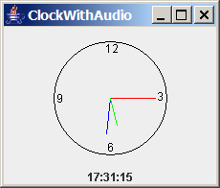
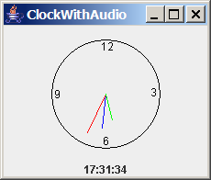
Case Study: Clock with Audio
The example creates an applet that displays a running clock and announces the time at one-minute intervals. For example, if the current time is 6:30:00, the applet announces, "six o’clock thirty minutes a.m." If the current time is 20:20:00, the applet announces, "eight o’clock twenty minutes p.m." Also add a label to display the digital time.
ClockWithAudio.java

Slide 40
Demo: Run Audio on Separate Thread
ClockWithAudioOnSeparateThread.java

Slide 41
运行线程池的静态类Excutors

Slide 42
Thread Pools
Executor interface for executing tasks in a thread pool and the ExecutorService interface for managing and controlling tasks. ExecutorService is a sub-interface of Executor.

Slide 43
Creating Executors
To create an Executor object, use the static methods in the Executors class.
ExecutorDemo.java

Slide 44
Thread Synchronization
A shared resource may be corrupted if it is accessed simultaneously by multiple threads. For example, two unsynchronized threads accessing the same bank account may cause conflict.

Slide 45
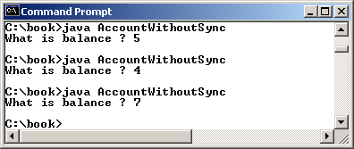
Example: Showing Resource Conflict
AccountWithoutSync.java

Slide 46
Race Condition

Slide 47
The synchronized keyword
public synchronized void deposit(double amount)

Slide 48
Synchronizing Instance Methods and Static Methods
A synchronized method acquires a lock before it executes.
an instance method: the lock is on the object for which the method was invoked.
a static method: the lock is on the class.

Slide 49
Synchronizing Instance Methods and Static Methods
AccountWithSync.java

Slide 50
Synchronizing Statements
synchronized (expr) {
statements;
}
The expression expr must evaluate to an object reference.

Slide 51
Synchronizing Statements vs. Methods
Any synchronized instance method can be converted into a synchronized statement.
public synchronized void xMethod() {
// method body
}
This method is equivalent to
public void xMethod() {
synchronized (this) {
// method body
}
}

Slide 52
Synchronization Using Locks

Slide 53
Example: Using Locks
AccountWithSyncUsingLock.java

Slide 54
Cooperation Among Threads

Slide 55
Cooperation Among Threads

Slide 56
Example: Thread Cooperation
ThreadCooperation.java

Slide 57
wait(), notify(), and notifyAll()
wait(), notify(), and notifyAll() ：必须在同步块或者同步方法中调用，否则会发生IllegalMonitorStateException 异常
wait() ：线程等待直到条件发生。一旦条件发生，可以利用notify() 或 notifyAll() 通知所有等待该线程的方法重新正常执行。
相当于对象级的Condition

Slide 58
Example: Using Monitor
当 wait()被调用时，暂停线程同时释放对象上的锁，等待重新获取锁。如果线程获得通知，则自动重新获取锁。
对象上的wait(), notify(), and notifyAll() 方法类似于一个条件上的 await(), signal(), and signalAll() 方法

Slide 59
Case Study: Producer/Consumer

Slide 60
Case Study: Producer/Consumer
ConsumerProducer.java

Slide 61
Blocking Queues

Slide 62
Concrete Blocking Queues

Slide 63
Producer/Consumer Using Blocking Queues
ConsumerProducerUsingBlockingQueue.java

Slide 64
Semaphores (Optional)
可以使用信号量来限制访问一个共享资源的线程数。
应用场景
限制并发访问数量：例如，限制同时访问数据库的线程数量，以避免数据库压力过大。
资源池：例如，数据库连接池，每个资源对应一个许可，线程使用资源前需获取许可，使用完后释放许可。

Slide 65
Semaphores (Optional)

Slide 66
Creating Semaphores

Slide 67
例子：改写前面的Account

Slide 68
Semaphore的其他方法
——isFair()：是否公平模式FIFO
——availablePermits()：获取当前可用的许可证数量
——acquierUninterruptibly()：当前线程尝试去阻塞的获取1个许可证(不可中断的)，当前线程获取了1个可用的许可证，则会停止等待，继续执行。
——acquireUninterruptibly(permits)：当前线程尝试去阻塞的获取permits个许可证。
——tryAcquire()：当前线程尝试去获取1个许可证。此过程是非阻塞的，它只是在方法调用时进行一次尝试。如果当前线程获取了1个可用的许可证，则会停止等待，继续执行，并返回true。如果当前线程没有获得这个许可证，也会停止等待，继续执行，并返回false。

Slide 69
Semaphore的其他方法（续）
——tryAcquire(permits) ：当前线程尝试去获取permits个许可证。此过程是非阻塞的，它只是在方法调用时进行一次尝试。如果当前线程获取了permits个可用的许可证，则会停止等待，继续执行，并返回true。如果当前线程没有获得permits个许可证，也会停止等待，继续执行，并返回false。
——tryAcquire(timeout,TimeUnit)：当前线程在限定时间内，阻塞的尝试去获取1个许可证。此过程是阻塞的，当前线程获取了可用的许可证，则会停止等待，继续执行，并返回true。当前线程等待时间timeout超时，则会停止等待，继续执行，并返回false。当前线程在timeout时间内被中断，则会抛出InterruptedException一次，并停止等待，继续执行。
——tryAcquire(permits,timeout,TimeUnit)
——drainPermits()：当前线程获得剩余的所有可用许可证。
——hasQueuedThreads()：判断当前Semaphore对象上是否存在正在等待许可证的线程。
——getQueueLength()：获取当前Semaphore对象上是正在等待许可证的线程数量。

Slide 70
CountDownLatch
倒计时门闩（不可以重置）
一种同步帮助，它允许一个或多个线程等待其他线程完成一系列操作后再继续执行
有个计数器。线程调用countdown()计数器时计数器减1，调用await()线程会阻塞，直到计数器归零。
使用场景：
主程序等待子程序完成任务
并行加载资源，全部完成后统一处理
模拟并发任务启动

Slide 71
CyclicBarrier
CyclicBarrier是一个同步器，允许一组线程相互之间等待，直到到达某个公共屏障点 (common barrier point)，再继续执行。
使用场景：
分阶段任务
重复同步
模拟并发测试

Slide 72
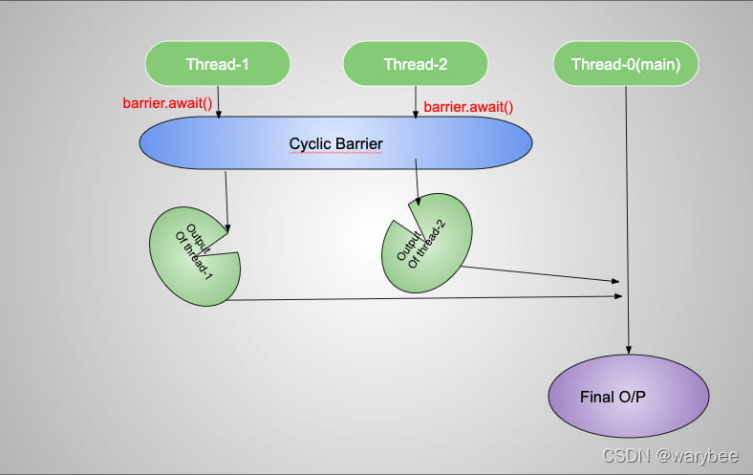
CyclicBarrier
大家都到齐了，才能一起走

Slide 73
CyclicBarrier核心方法
CyclicBarrier(int parties)
CyclicBarrier(int parties, Runnable barrierCommand)
await()
parties：需要等待的线程数量
barrierCommand：所有线程到达后，优先执行的任务
await()：线程到达屏障，阻塞等待
可以重置

Slide 74
public class CyclicBarrierDemo {
static CyclicBarrier c = new CyclicBarrier(2);
public static void main(String[] args) {
new Thread(new Runnable() {
@Override
public void run() {
try {
c.await();
} catch (InterruptedException | BrokenBarrierException e) {
e.printStackTrace();
}
//在子线程输出1
System.out.println("1");
}
}).start();
try {
c.await();
//在主线程输出2
System.out.println("2");
} catch (InterruptedException | BrokenBarrierException e) {
e.printStackTrace();
}
}
}

Slide 75
public class CyclicBarrierDemo {
//实例化CyclicBarrier，并指定回调函数
static CyclicBarrier c = new CyclicBarrier(2,new TestRunable());
public static void main(String[] args) {
new Thread(new Runnable() {
@Override
public void run() {
try {
c.await();
} catch (InterruptedException | BrokenBarrierException e) {
e.printStackTrace();
}
System.out.println("1");
}
}).start();
try {
c.await();
System.out.println("2");
} catch (InterruptedException | BrokenBarrierException e) {
e.printStackTrace();
}
}
static class TestRunable implements Runnable{
@Override
public void run() {
System.out.println("3");
}
}
}

Slide 76
Deadlock

Slide 77
Preventing Deadlock
Deadlock can be easily avoided by using a simple technique known as resource ordering.
资源排序技术：
例如：给要加锁的对象进行排序，必须按照顺序进行加锁。
资源重排通过为系统中的资源分配一个全局固定的编号顺序，要求线程按递增（或递减）顺序申请资源，从而破坏死锁的循环等待条件，达到预防死锁的目的。

Slide 78
死锁的例子
void transfer(Account from, Account to, int amount) {
synchronized (from) {
synchronized (to) {
from.debit(amount);
to.credit(amount);
}
}
}
如果A->B B->A 同时发生会死锁

Slide 79
资源重排
void transfer(Account from, Account to, int amount) {
Account first = from.getId() < to.getId() ? from : to;
Account second = from.getId() < to.getId() ? to : from;
synchronized (first) {
synchronized (second) {
from.debit(amount);
to.credit(amount);
}
}
}

Slide 80
Thread States
A thread can be in one of five states: New, Ready, Running, Blocked, or Finished.

Slide 81
Synchronized Collections
The classes in the Java Collections Framework are not thread-safe.
synchronization wrappers:
The Collections class provides six static methods for wrapping a collection into a synchronized version

Slide 82
Vector, Stack, and Hashtable
synchronizedCollection(Collection c) returns a new Collection object, in which all the methods that access and update the original collection c are synchronized.
For example, the add method is implemented like this:
public boolean add(E o) {
synchronized (this) { return c.add(o); }
}
The synchronized collections can be safely accessed and modified by multiple threads concurrently.
The methods in java.util.Vector, java.util.Stack, and Hashtable are already synchronized.
you should use java.util.ArrayList to replace Vector, java.util.LinkedList to replace Stack, and java.util.Map to replace Hashtable. If synchronization is needed, use a synchronization wrapper.

Slide 83
Fail-Fast ：遍历时要注意
The synchronization wrapper classes are thread-safe, but the iterator is fail-fast. This means that if you are using an iterator to traverse a collection while the underlying collection is being modified by another thread, then the iterator will immediately fail by throwing java.util.ConcurrentModificationException, which is a subclass of RuntimeException. To avoid this error, you need to create a synchronized collection object and acquire a lock on the object when traversing it. For example, suppose you want to traverse a set, you have to write the code like this:
Set hashSet = Collections.synchronizedSet(new HashSet());
synchronized (hashSet) { // Must synchronize it
Iterator iterator = hashSet.iterator();
while (iterator.hasNext()) {
System.out.println(iterator.next());
}
}
Failure to do so may result in nondeterministic behavior, such as ConcurrentModificationException.

Slide 84
SwingWorker ：一个有用的类
Java 6 introduced SwingWorker. SwingWorker is an abstract class that implements Runnable. You can define a task class that extends SwingWorker, run the time-consuming task in the task, and update the GUI using the results produced from the task.

Slide 85
SwingWorker

Slide 86
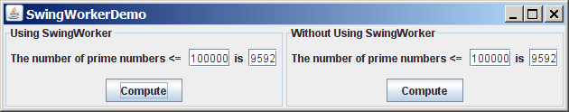
SwingWorker Demo
SwingWorkerDemo.java

Slide 87
TIP
Two things to remember when writing Swing GUI programs,
Time-consuming tasks should be run in SwingWorker.
Swing components should be accessed from the event dispatch thread only.

Slide 88
JProgressBar

Slide 89
JProgressBar Methods

Slide 90
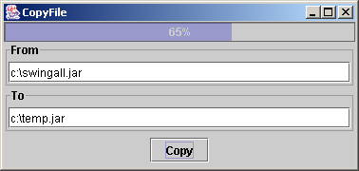
Example: JProgressBar Demo
Objective: Write a GUI application that lets you copy files. A progress bar is used to show the progress of the copying operation.
CopyFile.java

Slide 91
并行编程
Fork/Join框架
一个分解（fork）可以视为运行在一个线程上的独立任务。

Slide 92
ForkJoinTask和ForkJoinPool
ForkJoinTask定义一个任务，抽象类
在一个ForkJoinPool的实例中执行一个任务

Slide 93
JAVA中的可变长参数
public void printNumbers(int …numbers){
for(int num:numbers){
System.out.println(num)};
}
可变长参数类似于数组
必须是参数表的最后一个参数才能用可变长参数

Slide 94
相关的接口和类
Future：异步计算结果的占位符
以前主线程提交任务后，无法知道任务什么时候完成，想要结果，只能阻塞等待线程结束
异步执行
可以用get()查看结果，阻塞直到任务完成
带超时的get
判断任务状态 isDone()， isCancelled()
ForkJoinTask实现了Future接口

Slide 95
相关的接口和类
ForkJoinTask三个子类
RecursiveAction
RecursiveTask<V>
CountedCompleter<T>
ForkJoinPool实现ExecutorService

Slide 96
举例

Slide 97
public class MergeSort {
/** The method for sorting the numbers */
public static void mergeSort(int[] list) {
if (list.length > 1) {
// Merge sort the first half
int[] firstHalf = new int[list.length / 2];
System.arraycopy(list, 0, firstHalf, 0, list.length / 2);
mergeSort(firstHalf);
// Merge sort the second half
int secondHalfLength = list.length - list.length / 2;
int[] secondHalf = new int[secondHalfLength];
System.arraycopy(list, list.length / 2,
secondHalf, 0, secondHalfLength);
mergeSort(secondHalf);
// Merge firstHalf with secondHalf
int[] temp = merge(firstHalf, secondHalf);
System.arraycopy(temp, 0, list, 0, temp.length);
}
}
private static int[] merge(int[] list1, int[] list2) {
int[] temp = new int[list1.length + list2.length];
int current1 = 0; // Index in list1
int current2 = 0; // Index in list2
int current3 = 0; // Index in temp
while (current1 < list1.length && current2 < list2.length) {
if (list1[current1] < list2[current2]) {
temp[current3++] = list1[current1++];
} else {
temp[current3++] = list2[current2++];
}
}
while (current1 < list1.length) {
temp[current3++] = list1[current1++];
}
while (current2 < list2.length) {
temp[current3++] = list2[current2++];
}
return temp;
}
}

Slide 98
Future接口的弱点
get()必须等待
只能在 get()时捕获异常
不能外部设置结果
不支持链式处理
Java 8以后给出了CompletableFuture

Slide 99

问题解决逻辑

Slide 100
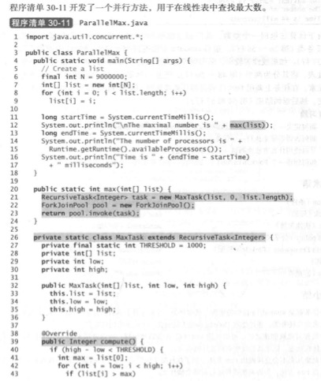
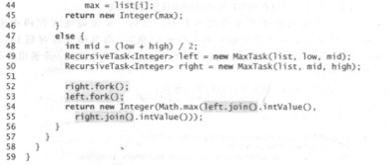

Slide 101
Appendix
Static block 静态块
Initializing block 初始化块
Synchronized block 同步块
Ordinary block 普通块
可变长参数

Slide 102
Static block
静态块
写在类里static{}
一个类只在装载时运行一次，用于初始化一些类相关的方法。

Slide 103
Initializing block
初始化块
写在构造方法前面
每次生成对象时调用一次
主要用法是将构造方法中共同部分放到构造块中统一运行

Slide 104
Synchronized block
同步块
加锁 用于并发操作
例子前面已讲

Slide 105
Ordinary block
普通程序块

Slide 106
public class Line {
static {
System.out.println("静态代码块执行：loading line");
}
public static String s = getString();
private static String getString() {
System.out.println("给静态变量赋值的静态方法执行：loading line");
return "ss";
}
public static void test() {
System.out.println("普通静态方法执行：loading line");
}
public Line() {
System.out.println("构造方法执行：loading line");
}
{
System.out.println("构造代码块执行");
}
}

Slide 107
线程池
Executor接口来执行线程池中的任务
ExecutorService接口来管理和控制任务
Excutors类中静态方法：

